Slide 1
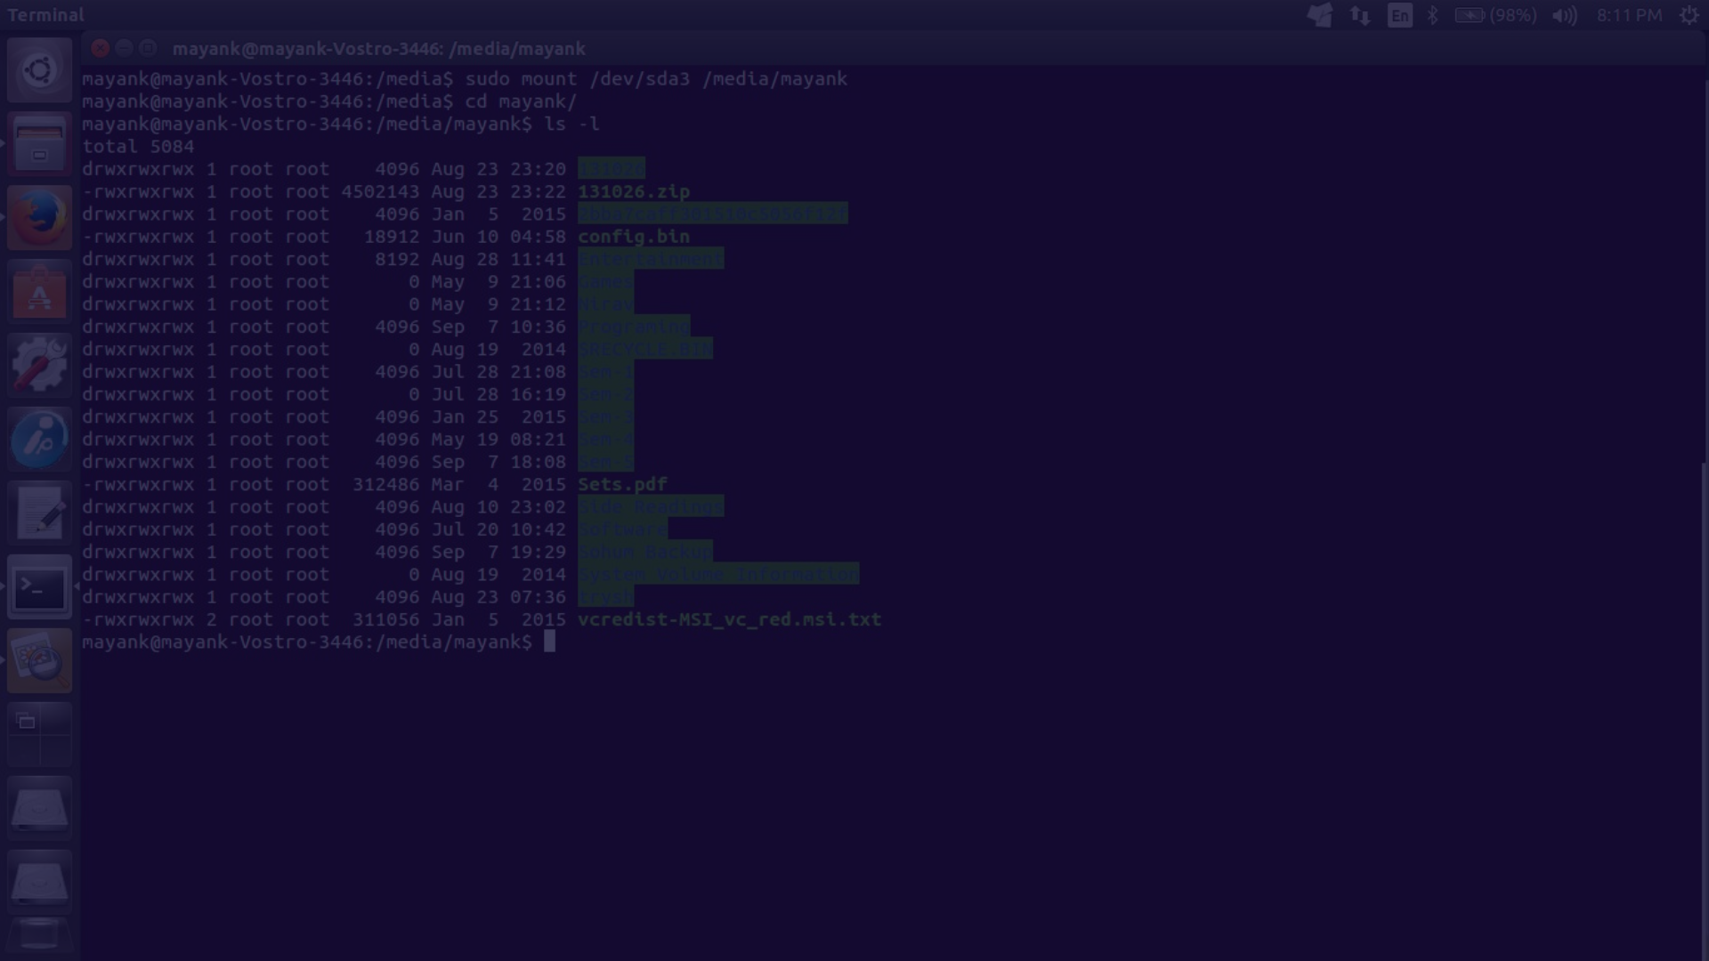


Mastering File Handling in Linux
If you're new to Linux or just looking to refresh your file handling skills, this guide is for you. Below are 22 powerful and versatile commands to help you navigate and manipulate your files and directories with ease.
by Sai Rohith

Slide 2
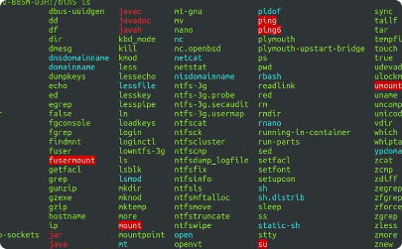
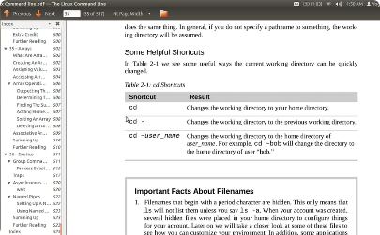
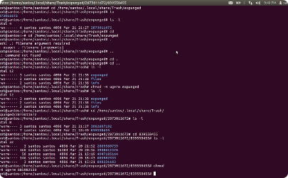
List and Navigate with ls, pwd, and cd
List Files and Directories
Print Working
Change Your Directory
Directory
The ls command is your go-to tool for listing the contents of a directory. Use options like -a, -l, and -h to customize the output.
To move around in the file system, use the cd command followed by the path of the target directory. Use ".." to go back to the parent directory.
Need to know which directory you're currently in? The pwd command will show you the full path of your current working directory.

Slide 3
Create and Delete Directories with mkdir and rmdir
Create a New Directory
Remove an Empty Directory
The Power of Directories
Use the mkdir command to create a new directory with the specified name.
If you need to delete a directory, use the rmdir command. Note that this command only works on empty directories.
Directories (folders) are a fundamental part of the file system. They provide a way to organize your files and keep your system tidy. A good folder structure can make your life much easier!

Slide 4

All Linux Commands Using ls
In addition to listing files and directories, the ls command has many powerful options that allow you to filter, sort, and customize your output. Here are some useful commands:
ls -a: list all files, including hidden ones
ls -l: list files in long format
ls -h: list files with human-readable file sizes
ls -t: list files by modification time
ls -S: list files by size
ls -r: list files in reverse order
ls -R: list files recursively
Use these commands to take your file management skills to the next level.

Slide 5
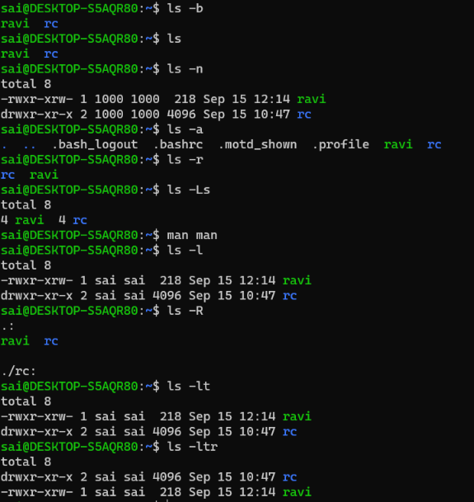
LS COMMANDS
Description: The ls command in Linux is used to list files and directories in the current directory or a specified location. It provides information like file names, sizes, permissions, and timestamps. It is a fundamental tool for navigating and managing files in a terminal.
Syntax: ls [OPTION]... [FILE]...
[OPTION]: Various options for customizing the output.
[FILE]...: Optional, specify one or more file or directory names to list their contents.

Slide 6
Create and Manipulate Files with touch, cp, mv, and rm
1
Create a New File
The touch command can be used to create a new, empty file. It can also be used to update the timestamps of an existing file.
Copy or Move Files
2
The cp and mv commands let you copy and move files and directories as needed. These commands can be customized with various options to suit your needs.
3
Delete Files You Don't Need
Sometimes you need to clean up your directory and get rid of files you no longer need. The rm command can help you do just that.

Slide 7
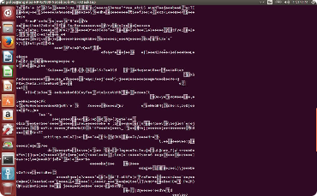
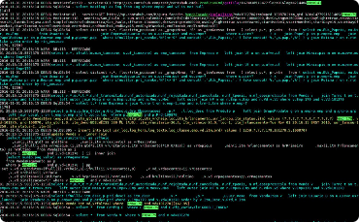
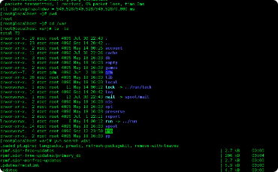
View File Contents with cat, more, less, head, and tail
Display File Contents
View the Beginning or End of a File
The Power of Piping
One of the strengths of Linux is its ability to combine commands using pipes. With pipes, you can take the output of one command and use it as input to another command. This technique can be incredibly powerful and save you a ton of time.
The cat command is a quick way to display the contents of a file. For longer files, try using the more or less command to view the contents one screen at a time.
If you only need to see the beginning or end of a file, save yourself some time and use the head or tail command.

Slide 8
Manage Permissions and Ownership with chmod and chown
Change File Permissions
Change File Ownership
The chmod command lets you change the read, write, and execute permissions on a file. You can modify permissions for the owner, group, and others. Experiment with different permissions to find the right configuration for your needs.
The chown command lets you change the ownership of a file. You can set the owner and group, as well as a few other attributes. This is useful if you need to give someone else access to a file or take ownership of someone else's file.
Read (r): allows you to see the contents of the file
Remember that changing ownership can be dangerous if you don't know what you're doing. Be careful!
Write (w): allows you to modify the contents of the file
Execute (x): allows you to run the file as a program

Slide 9
Change File Permissions with chmod
The chmod command is used to change file permissions in Linux. Use numbers or letters to specify the permissions. Here are some useful commands:
chmod u+x FILE: add execute permission for the owner
chmod g+w FILE: add write permission for the group
chmod o-r FILE: remove read permission for others
chmod 755 FILE: set read, write, and execute permission for the owner, and read and execute permission for others
chmod -R u=rwX,go=rX DIRECTORY: set permissions recursively for a directory and its contents
Use these commands to control access to your files and directories.

Slide 10
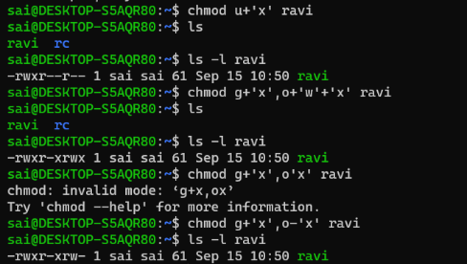
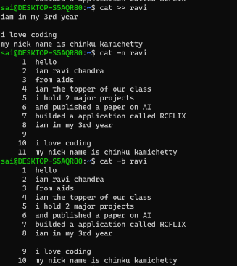
Commands
CHMOD
Description:
CAT
The chmod command in Linux changes file permissions, allowing users to control read, write, and execute access to files and directories.
Description: The cat command in Linux is used to concatenate and display the contents of one or more files. It's commonly used for reading file content and displaying it in the terminal.
Syntax: chmod <permissions> <file_name>
Syntax: cat [OPTION]... [FILE]...

Slide 11
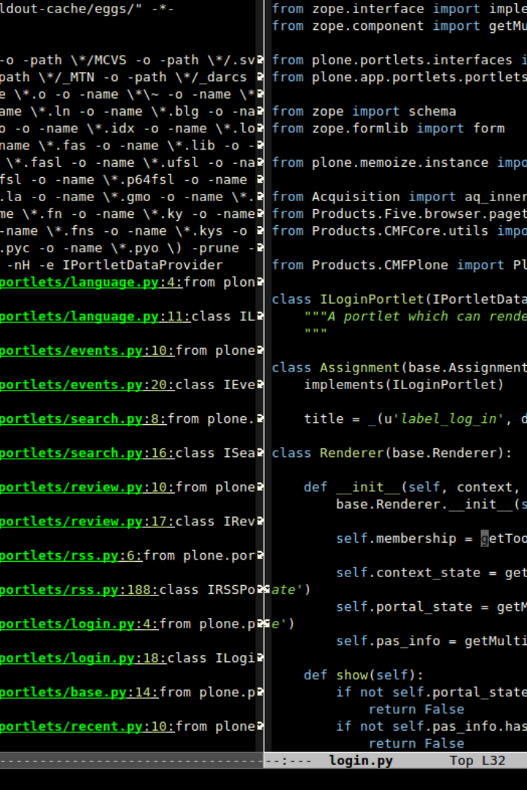
Find Files and Directories with find and grep
1
Search for Files
2
Search for Text Patterns
3
Avoid Duplicate Searches
The find command is your go-to tool for finding files and directories. You can search based on name, size, permission, and other criteria. This command can be a bit complex, so make sure to consult the manual pages for help if you get stuck.
The grep command is a text search tool that lets you search for text patterns within files. This command is incredibly powerful and can save you a ton of time if you need to find a specific piece of information buried deep within a file.
If you find yourself performing the same search frequently, save yourself some time by using history and aliases. The history command shows you a list of your past commands, while an alias is a shortcut for a longer command. These tools can be customized and are incredibly useful once you get the hang of them.

